Slide 1
Campus violence prevention and student accountability: perspectives from indaba dialogic forum, restorative justice and peace education
Jean Chrysostome Kiyala Kimbuku, PHD.
Honorary Research Associate at the International Centre of Nonviolence (ICON)
Durban University of Technology
ML Sultan Campus, Durban, South Africa

Slide 2
Why there is violence in society?
For Schirch (2004), inter-human violence originates from choices regarding
What they decide to consume
How they interact with one another
When they deem the use of force against others as necessary to satisfy their needs
For World Health Organization, violence = the pursuit of individuals’ unfettered whims at the expense of others’ rights
EGO AND SELFISHNESS

Slide 3
Factors
Substance abuse
Excessive alcohol consumption
Consequences
Low self-esteem
Depression
Retaliation, etc.
Inability to self-regulation
Anger/bitterness
Drop-outs, etc.

Slide 4
Punitive justice
Retributive sanctions
Lost trust
Restorative justice
Repair Harm
Regain Trust
Rebuild community
Virtual recidivism
Expulsion
Reintegration

Slide 5
RJ AS STUDENTS’ ACCONUNTABILITY REVOLUTION
For David Karp (2004),
Increasing incidents of campus violence raise the question about the effectiveness of punitive sanctions in making campus colleges safer spaces.

Slide 6
RJ Praxis
Restorative justice encourages dialogue among victims and offenders to construct plans of action that hold offenders accountable and meet victims’ needs. Restorative processes help educate community members about the need for civic commitment, and build student capacity for evaluating the impact of their
behavior on the community (Karp, D., & Conrad, S. (2005, p. 317)

Slide 7
Campus Peacebuilding strategies
Restorative justice (RJ)
Indaba (never investigated…)
Peace education
Universities around the world are moving towards restorative justice approaches in tackling violence (Rinker and Jonason 2014, Wilson 2006)
RJ sanctions: apology, restitution and enlightened community service (Karp, D. & Conrad, S. 2005)

Slide 8
Indaba Dialogic Institution
Indaba is proposed as a viable model of conflict transformation and “problem-solving” on campus.
Part of African long tradition of conflict resolution
Rooted in a humanistic and communitarian conception of the human person
In pre-colonial Africa, justice was handled by the council of elders

Slide 9
Variations In Indaba Functionality
Indaba = indigenous jurisprudence—a non-adjudicative dispute resolution institution, and it has also incentivized the framework of the KwaZulu-Natal Bill of Rights, as noted by Hund (1989)
It serves as legal framework in which various social groups and individual rights are recognized in absolute respect of what inspires values, in both the Western and African worldview (Hund 1989).
Based on Ubuntu and African Palaver

Slide 10
Indaba and Ubuntu
Ubuntu implies a humanistic spirit which inspires reconciliation (Nabudere 2005), instead of retaliation for the harm/hurt.
Ubuntu underlies the notion of human rights and dignity (Metz 2011),
Ubuntu sets the ground for restorative justice praxis instead of punishment (Gade 2013, Louw 2008).
Ubuntu is prioritized during Indaba for peaceful dispute settlement and the attainment of the common good.

Slide 11
Indaba and the African Palaver
The African Palaver, way of settling scores without recourse to violent means.
Stakeholders discuss matters in a friendly, amicable and respectful manner
All are partners in solving the problem and making decision
The ultimate end of is reconciliation (Scheid 2011).

Slide 12
Structure of the Zulu Indaba
Ingonyama yamaZulu
(The Zulu Monarch)
amakhosi
(chiefs)
Induna/
headman
Induna/headman
amakhosi
(chiefs)
Induna/headman
Induna/headman

Slide 13
Structure of Indaba institution
Induna
(overseer)
Ikomidi
(Committee)
The Deputy nduna
Secretary
Izihambeli
(delegates)
interest groups
Induna is designated by local leaders; they facilitate indaba and reports
The committee and delegates from various groups assist Induna
Duputy nduna and secretary work together with the Induna and stakeholders
various institutions

Slide 14
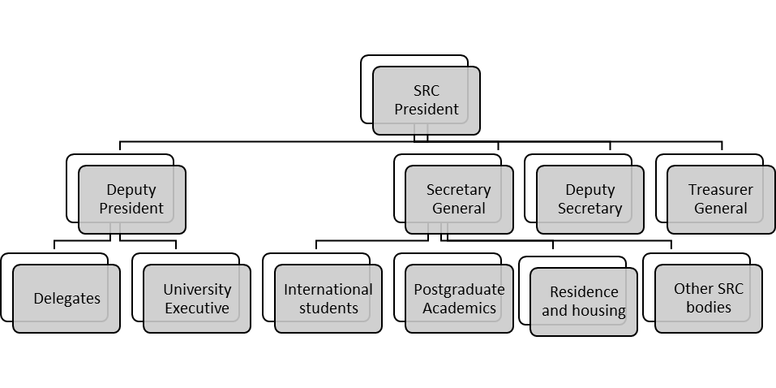

Slide 15
Conclusions
Indaba appears to be a realistic approach to holding students accountable and building peace on campus.
Since “colleges are not correctional facilities” (Karp and Conrad 2005, 318), a student who poses a serious threat to the safety of others must be expelled.
Restorative sanctions should prevail during and a Campus indaba: reparation, restitution, rehabilitation and reintegration should be prioritized.

